Slide 1
The Respiratory System: Pulmonary Ventilation
16

Slide 2
Chapter Outline
16.1 Overview of Respiratory Function
16.2 Anatomy of the Respiratory System
16.3 Forces for Pulmonary Ventilation
16.4 Factors Affecting Pulmonary Ventilation
16.5 Clinical Significance of Respiratory Volumes and Air Flows

Slide 3
16.1 Overview of Respiration
Internal respiration
Oxidative phosphorylation
External respiration
Pulmonary ventilation
Exchange between lungs and blood
Transportation in blood
Exchange between blood and body tissues

Slide 4
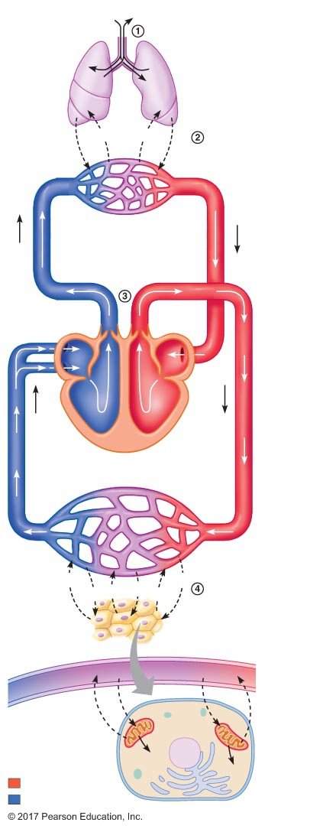
Figure 16.1 Relationship between external respiration and internal respiration.
O ₂
CO ₂
Lungs
O ₂
CO ₂
CO ₂
O ₂
Pulmonary capillaries
O ₂
CO ₂
Pulmonary veins
Pulmonary arteries
External
respiration
O ₂
CO ₂
Heart
Systemic veins
Systemic arteries
Systemic capillaries
CO ₂
CO ₂
O ₂
O ₂
O ₂
CO ₂
Capillary
Cells in tissues
throughout body
CO ₂
O ₂
CO ₂
O ₂
Internal
respiration
Mitochondria
Cell
ATP
ATP
Oxygenated blood
Deoxygenated blood

Slide 5
16.2 Anatomy of the Respiratory System
Upper airways
Respiratory tract
Structures of the thoracic cavity

Slide 6
Upper Airways
Air passages of the head and neck
Nasal cavities
Oral cavity
Pharynx

Slide 7
The Respiratory Tract
Airways from pharynx to lungs
Larynx
Conducting zone
Respiratory zone

Slide 8
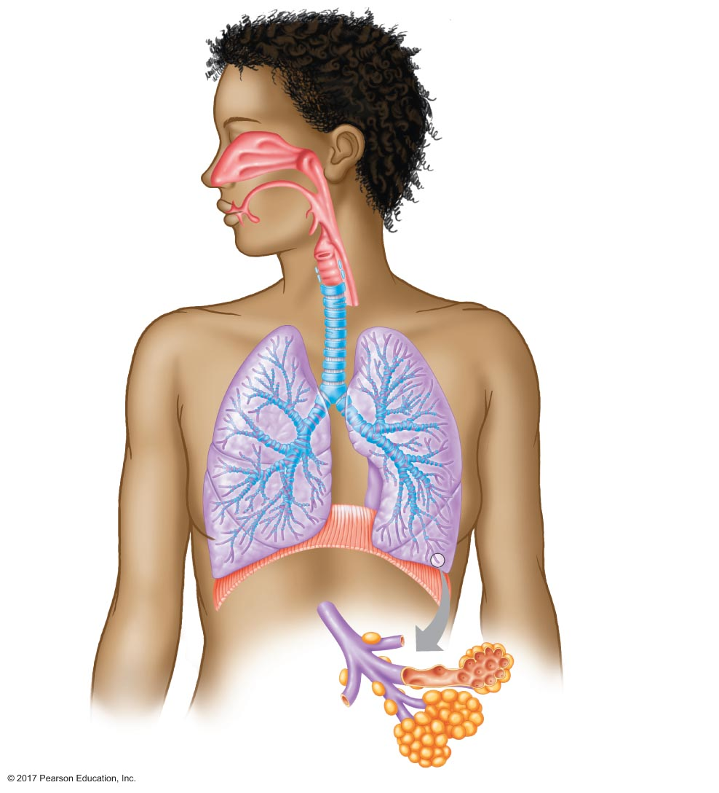
Figure 16.2 Anatomy of the upper airways and the respiratory tract.
Nasal cavity
Pharynx
Oral cavity
Upper airways
Epiglottis
Larynx
Glottis
Trachea
Esophagus
Cartilage rings
Right lung
Left lung
Primary bronchi
Respiratory tract
Secondary bronchi
Tertiary bronchi
Diaphragm
Terminal
bronchioles
Terminal
bronchiole
Respiratory
bronchioles
Alveolar sac
Alveoli

Slide 9
The Respiratory Tract
Conducting zone
Larynx
Glottis
Epiglottis
Trachea
2.5 cm diameter
10 cm long
15–20 C-shaped bands of cartilage

Slide 10
The Respiratory Tract
Conducting zone
Bronchi
Secondary bronchi
Three on right side to three lobes of right lung
Two on left side to two lobes of left lung
Tertiary bronchi
20–23 orders of branching
Bronchioles
Less than 1 mm in diameter
Terminal bronchioles

Slide 11
The Respiratory Tract
Functions of the conducting zone
Air passageway: 150 mL in volume (dead space)
Increases air temperature to body temperature
Humidifies air
Epithelium of the conducting zone
Goblet cells
Secrete mucus
Ciliated cells
Cilia move particles toward mouth
Mucus escalator

Slide 12
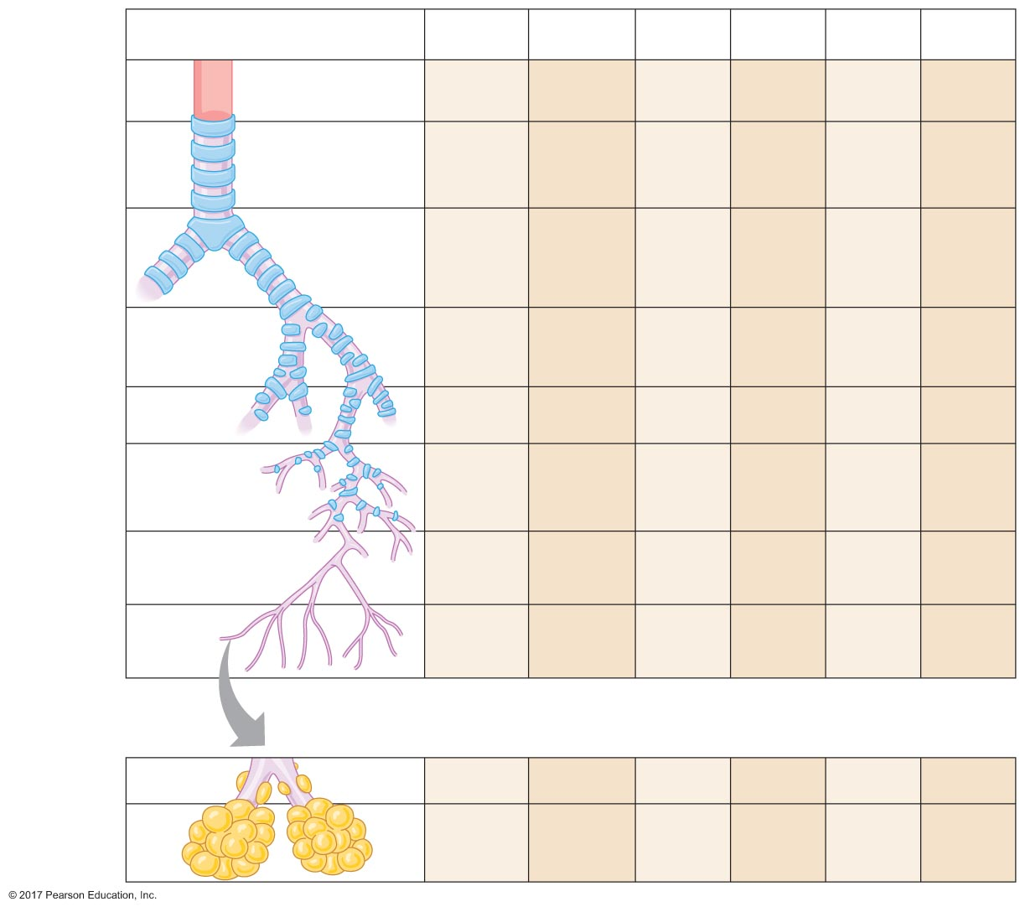
Figure 16.3 Anatomical features of the conducting and respiratory zones of the respiratory tract.
Structure
Inner
diameter (mm)
Cilia
Goblet cells
Cartilage
Smooth
muscle
Larynx
35–45
+++
+++
+++
0
Trachea
20–25
+++
+++
+++
(C-shaped)
+
Primary
bronchi
12–16
+++
++
+++
(rings)
++
Secondary
bronchi
10–12
+++
++
+++
(plates)
++
Conducting
zone
Tertiary
bronchi
8–10
+++
++
++
(plates)
++
Smaller
bronchi
1–8
+++
+
+
(plates)
++
Bronchioles
0.5–1
++
+
0
+++
Terminal
bronchioles
<0.5
++
0
0
+++
Respiratory
bronchioles
<0.5
+
0
0
+
Respiratory
zone
Alveolar
sacs
0.3
0
0
0
0

Slide 13
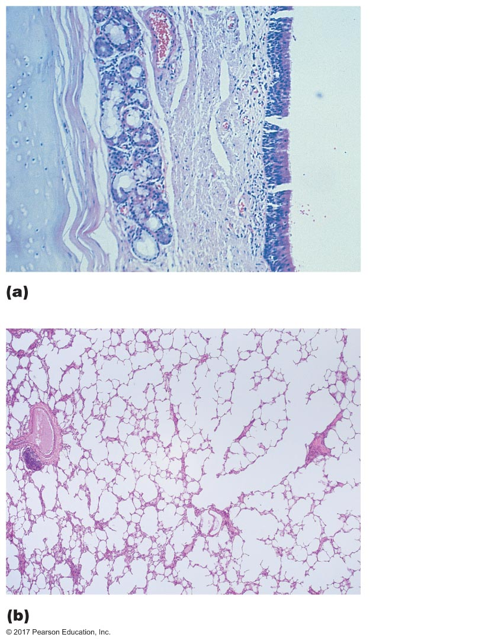
Figure 16.4 Respiratory tract epithelia.
Lumen of
trachea
Ciliated cells
Connective
tissue
Glands
Cartilage
Alveolar duct
Respiratory
bronchiole
Alveoli

Slide 14
The Respiratory Tract
Function of the respiratory zone
Exchange of gases between air and blood
Mechanism of action: diffusion
Structures of the respiratory zone
Respiratory bronchioles
Alveolar ducts
Alveoli
Alveolar sacs

Slide 15
The Respiratory Tract
Epithelium of the respiratory zone
Respiratory membrane
Epithelial cell layer of alveoli
Endothelial cell layer of capillaries

Slide 16
The Respiratory Tract
Alveoli
Site of gas exchange
300 million alveoli in the lungs (size of tennis court)
Rich blood supply: capillaries form sheet over alveoli
Alveolar pores
Type I alveolar cells: make up wall of alveoli
Single layer of epithelial cells
Type II alveolar cells: secrete surfactant
Alveolar macrophages

Slide 17
The Respiratory Tract
Respiratory membrane
Barrier for diffusion
Type I cells + basement membrane
Capillary endothelial cells + basement membrane
0.2 μm thick

Slide 18
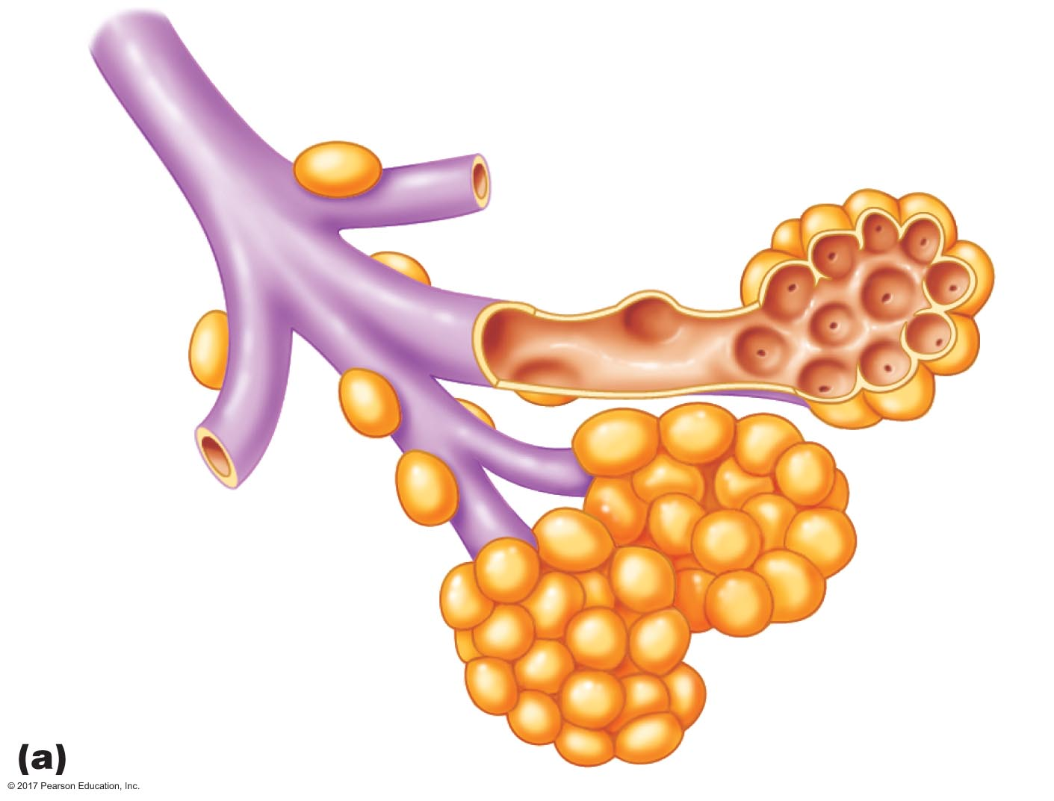
Figure 16.5a Anatomy of the respiratory zone.
Terminal bronchiole
Alveolar duct
Respiratory
bronchiole
Alveoli
Alveolar sac

Slide 19
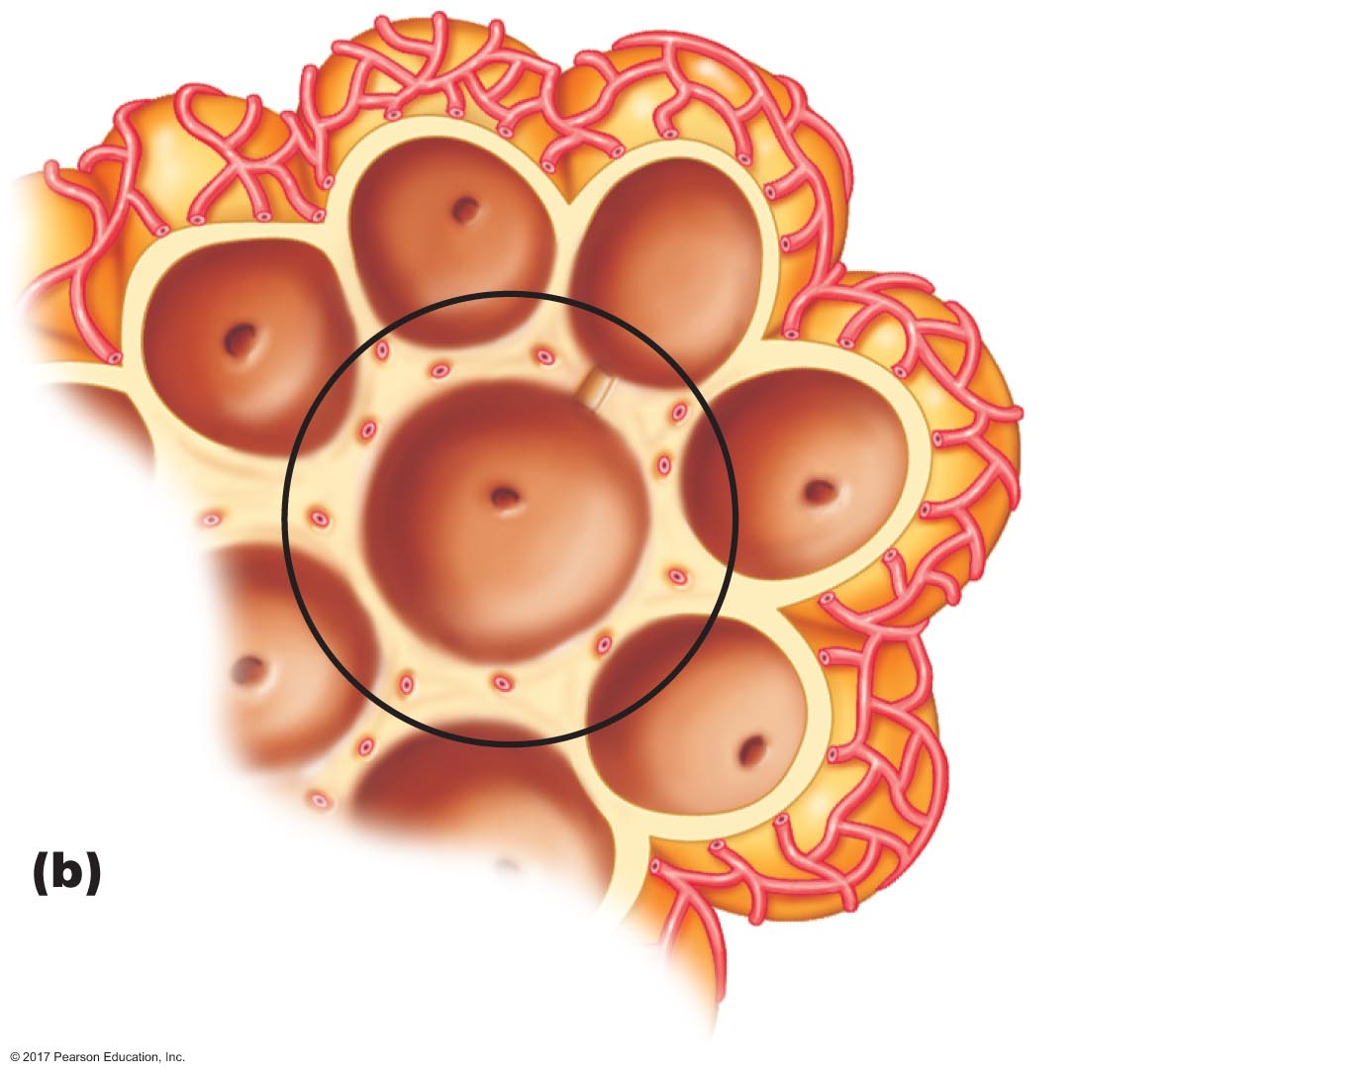
Figure 16.5b Anatomy of the respiratory zone.
Capillary network
Alveolar
pores

Slide 20
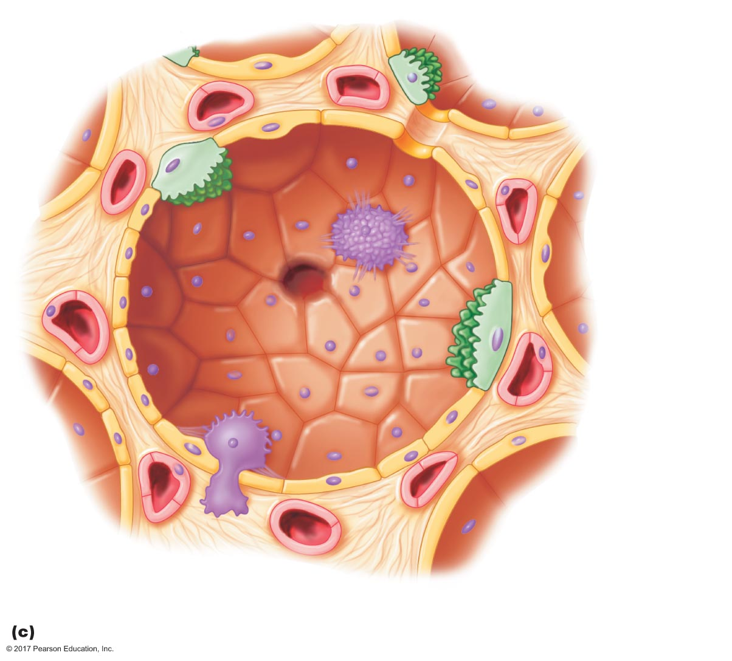
Figure 16.5c Anatomy of the respiratory zone.
Capillary
Type I
cell
Type II
cell
Alveolar pores
Capillary
Alveolar
macrophage

Slide 21
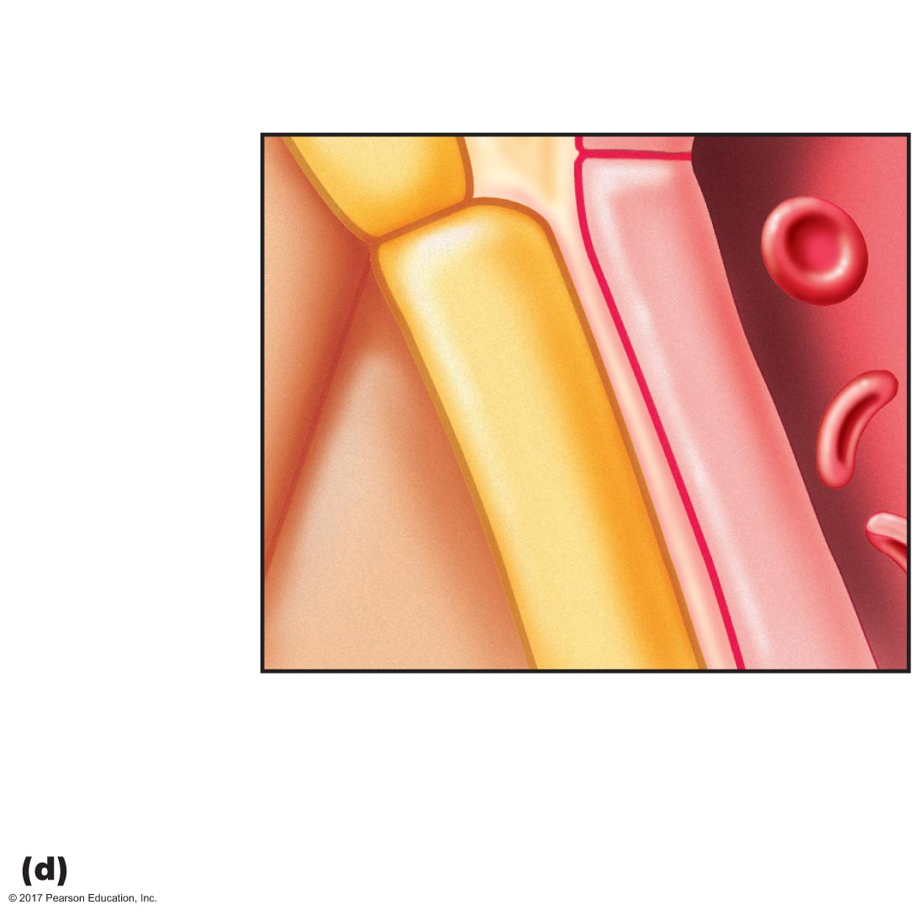
Figure 16.5d Anatomy of the respiratory zone.
Erythrocytes
Capillary
Capillary
endothelium
Alveolar
epithelium
Fused
basement
membrane
Alveolar
air space
Respiratory
membrane (0.2 μm)

Slide 22
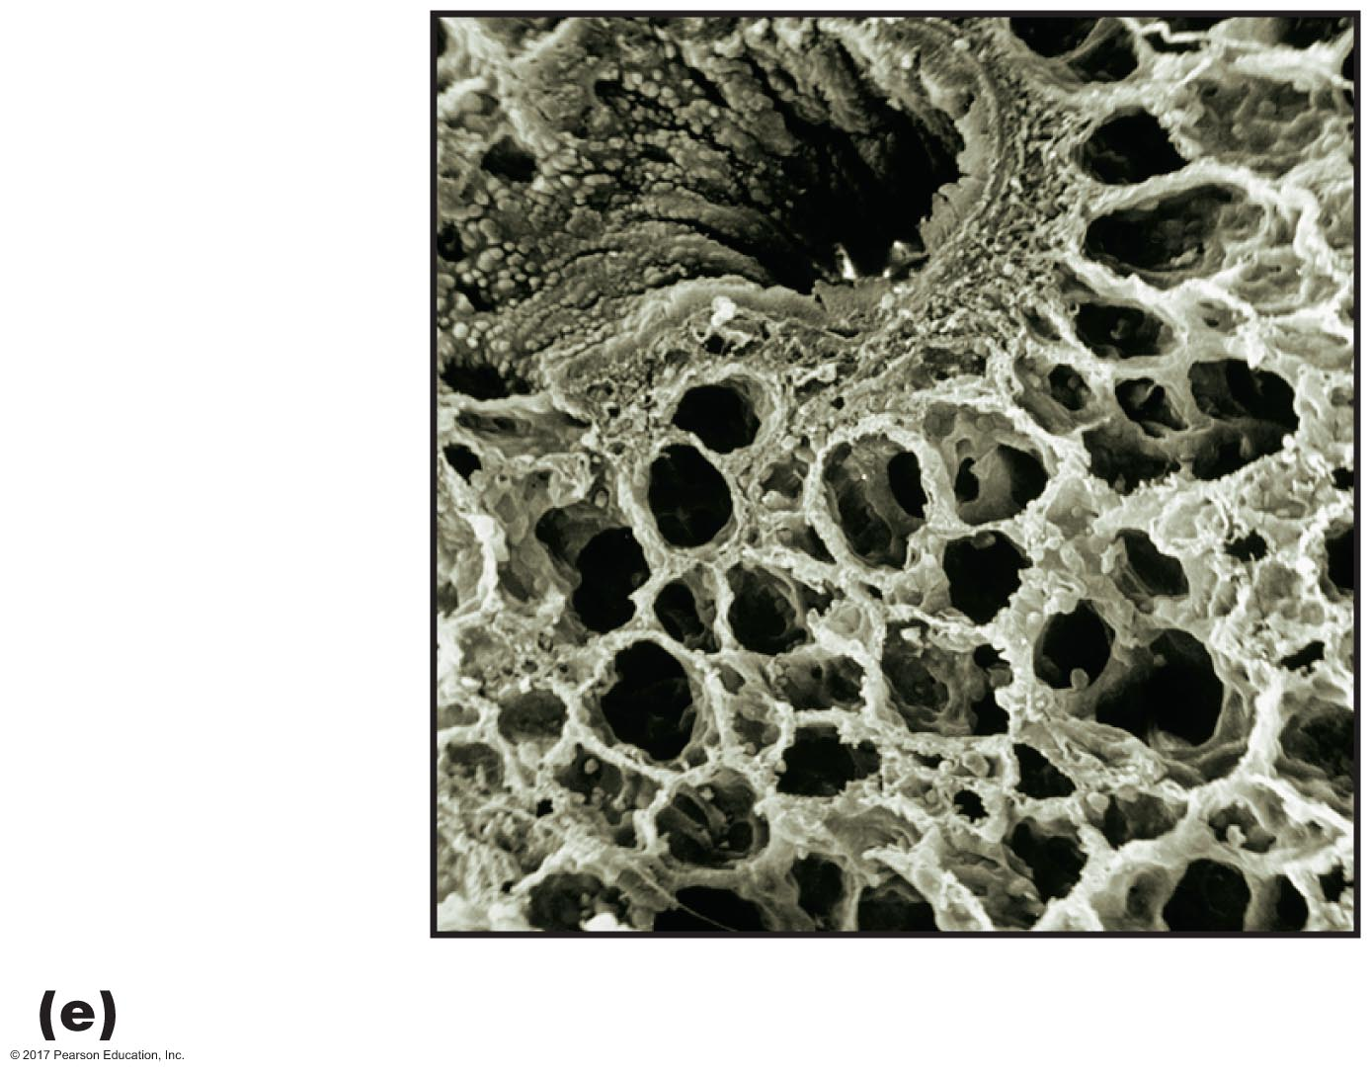
Figure 16.5e Anatomy of the respiratory zone.
Bronchiole
Alveoli

Slide 23
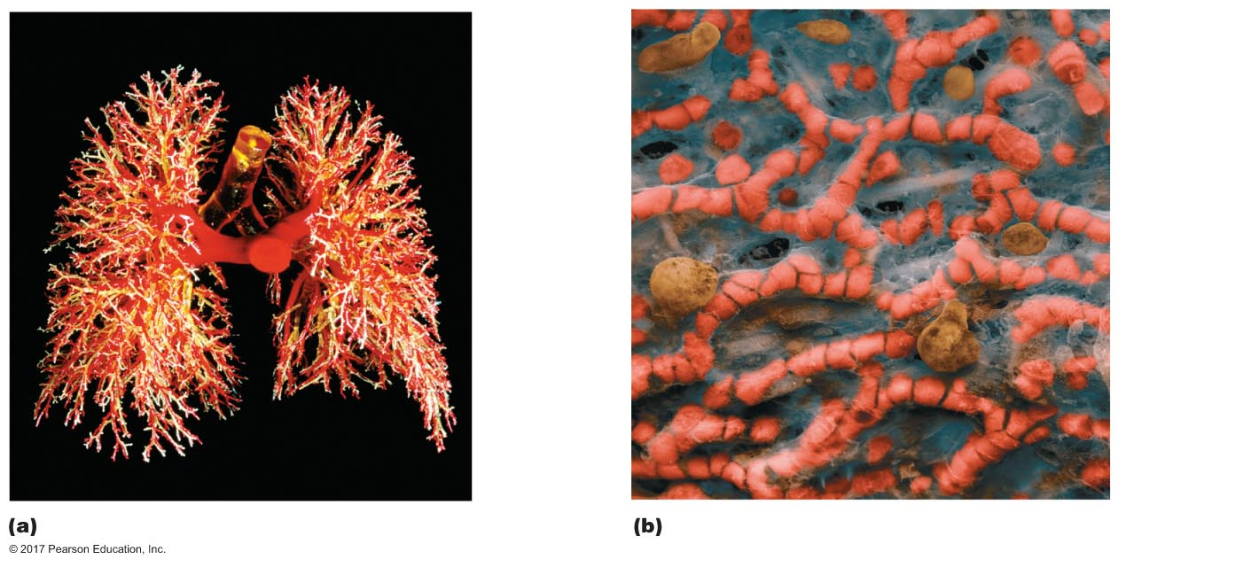
Figure 16.6 Blood supply to the lungs.
Trachea
Alveoli
Primary
bronchus
Pulmonary
artery
Capillaries

Slide 24
Structures of the Thoracic Cavity
Chest wall: airtight, protects lungs
Rib cage
Sternum
Thoracic vertebrae
Muscles: internal and external intercostals, diaphragm
Pleura: membrane lining of lungs and chest wall
Pleural sac around each lung
Intrapleural space is filled with intrapleural fluid
Volume = 15 mL

Slide 25
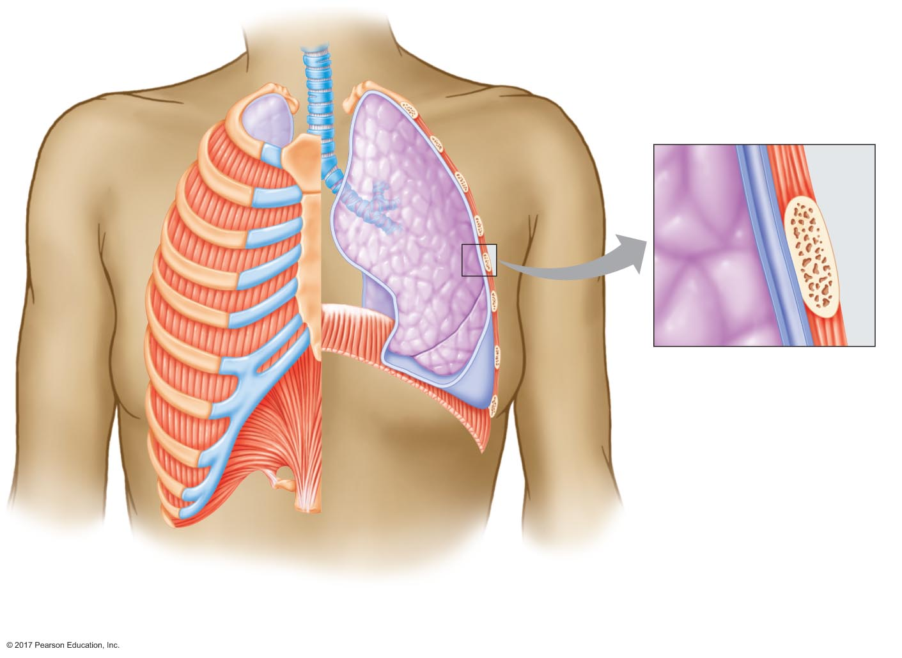
Figure 16.7 Chest wall and pleural sac.
Lung
Lung
Intercostal muscle
Rib
Intercostal
muscles
Pleural sac
Visceral
pleura
Parietal
pleura
Intrapleural
space
Diaphragm
Pleural sac
Chest wall
(rib cage, sternum,
thoracic vertebrae,
connective tissue,
intercostal muscles)

Slide 26
16.3 Forces for Pulmonary Ventilation
Air moves in and out of lungs by bulk flow
Pressure gradient drives flow
Air moves from high to low pressure
Inspiration: pressure in lungs less than atmospheric pressure
Expiration: pressure in lungs greater than atmospheric pressure

Slide 27
Pulmonary Pressures
Atmospheric pressure = P_{atm}
Intra-alveolar pressure = P_{alv}
Pressure of air in alveoli
Intrapleural pressure = P_{ip}
Pressure inside pleural sac
Transpulmonary pressure = P_{alv} – P_{ip}
Distending pressure across the lung wall

Slide 28
Pulmonary Pressures
Atmospheric pressure
760 mm Hg at sea level
Decreases as altitude increases
Increases under water
Other lung pressures are given relative to atmospheric pressure (set P_{atm} = 0 mm Hg)

Slide 29
Pulmonary Pressures
Intra-alveolar pressure
Pressure of air in alveoli
Given relative to atmospheric pressure
Varies with phase of respiration
During inspiration = negative (less than atmospheric)
During expiration = positive (more than atmospheric)
Difference between P_{alv} and P_{atm} drives ventilation

Slide 30
Pulmonary Pressures
Intrapleural pressure
Pressure inside pleural sac
Always negative under normal conditions
Always less than P_{alv}
Varies with phase of respiration
At rest, –4 mm Hg
Negative due to elasticity in lungs and chest wall
Lungs recoil inward as chest wall recoils outward
Opposing forces pull on intrapleural space
Surface tension of intrapleural fluid prevents wall and lungs from pulling apart

Slide 31
Pulmonary Pressures
Transpulmonary pressure
Transpulmonary pressure = P_{alv} – P_{ip}
Distending pressure across the lung wall
Increase in transpulmonary pressure
Increases distending pressure across lungs
Causes lungs (alveoli) to expand, increasing volume

Slide 32
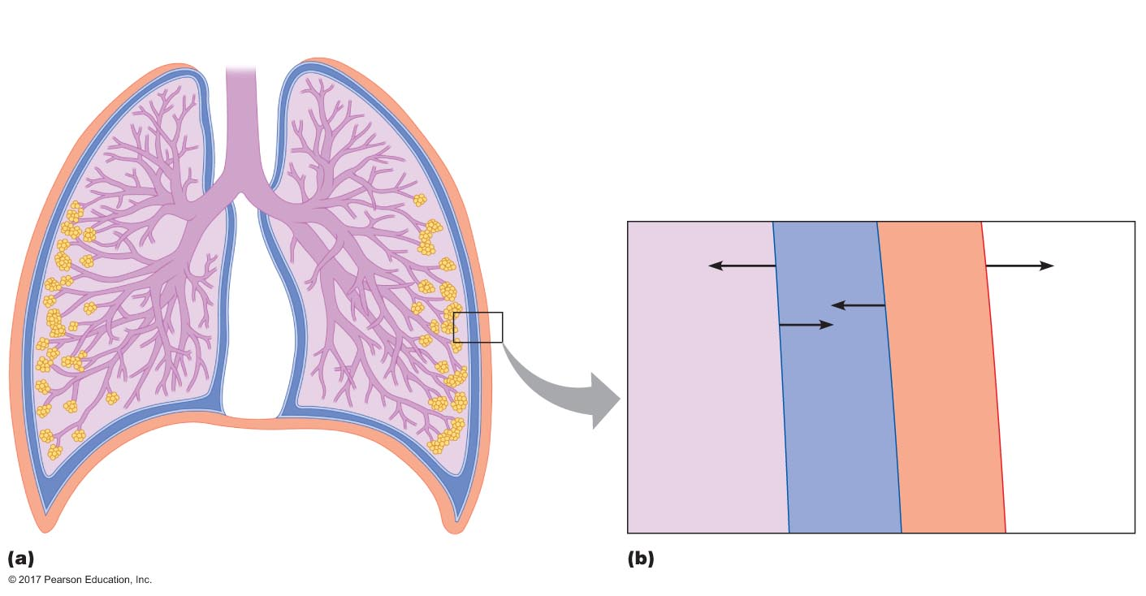
Figure 16.8 Pleural pressures at rest.
Atmospheric pressure (P_{atm})
760 mm Hg (0 mm Hg used as reference)
Chest wall
Pleural sac
Intrapleural pressure (P_{ip})
756 mm Hg (–4 mm Hg relative to atmosphere)
Intra-alveolar pressure (P_{alv})
760 mm Hg (0 mm Hg relative to atmosphere)
Transpulmonary pressure =
P_{alv} – P_{ip} = 4 mm Hg
Lung
Pleural sac
Chest wall
Elastic
recoil of
lung
Elastic recoil
of chest wall
Force due
to negative
intrapleural
pressure
Volume of air in
lungs is at
functional
residual capacity
Diaphragm
P_{alv} = 0 mm Hg
P_{ip} = –4 mm Hg

Slide 33
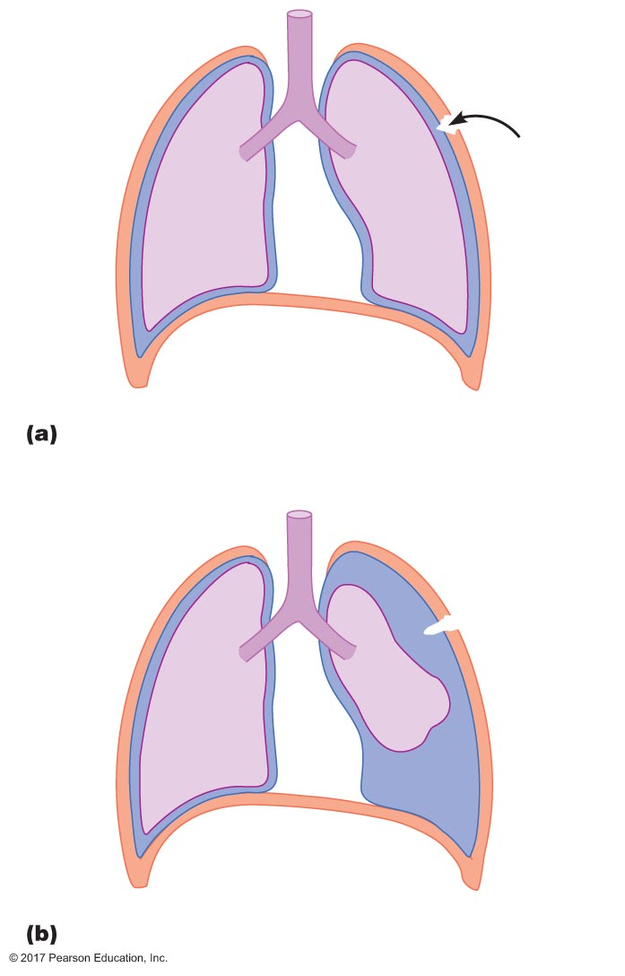
Figure 16.9 Pneumothorax.
Pneumothorax
Chest wall
Pleural
sac
Air
Lung
P_{alv} = 0
mm Hg
P_{ip} = –4 mm Hg
P_{alv} = 0
mm Hg
P_{ip} = 0 mm Hg

Slide 34
Mechanics of Breathing
Movement of air in and out of lungs occurs due to pressure gradients
Mechanics of breathing describes mechanisms for creating pressure gradients

Slide 35
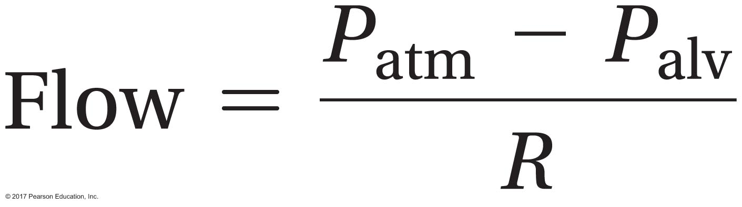
Mechanics of Breathing
Forces for air flow
Force for flow = pressure gradient
Atmospheric pressure remains constant (during breathing cycle)
Thus alveolar pressure changes affect gradients
Boyle's law: pressure is inversely related to volume
Can change alveolar pressure by changing its volume
Resistance to air flow (R) is related to airway radius and mucus

Slide 36
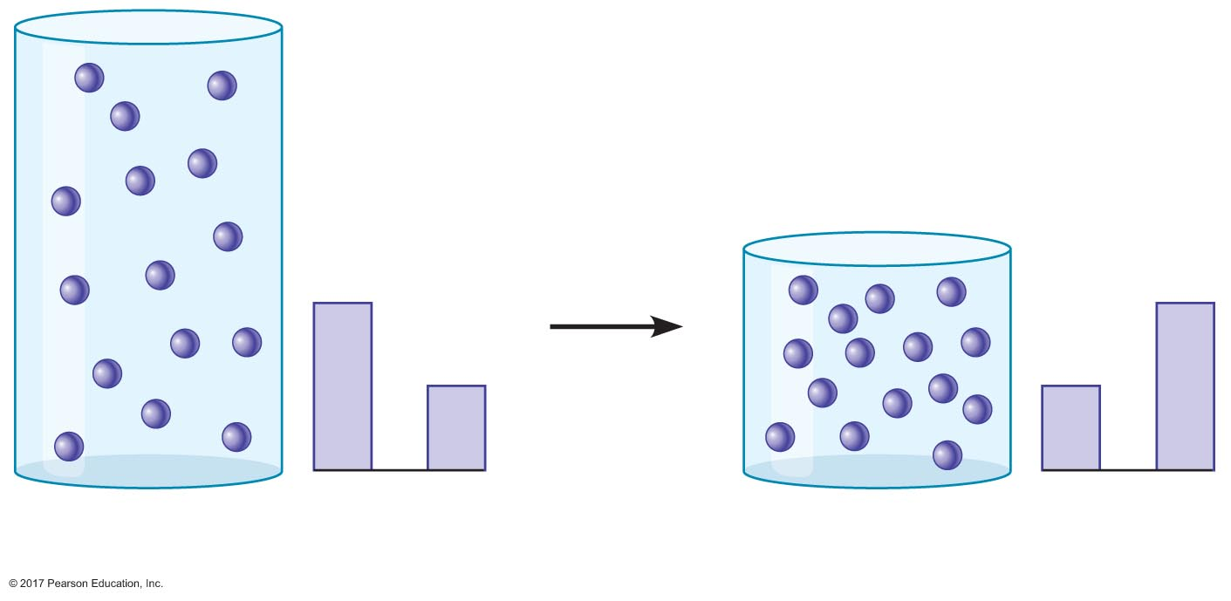
Toolbox 16.3
n and T
are constant
V₁
P₁
V₂
P₂
Container 1: V₁ = 2 P₁ = 1
Container 2: V₂ = 1 P₂ = 2

Slide 37
Mechanics of Breathing
Determinants of intra-alveolar pressure
Factors determining intra-alveolar pressure
Quantity of air in alveoli
Volume of alveoli
Lungs expand—alveolar volume increases
P_{alv} decreases
Pressure gradient drives air into lungs
Lungs recoil—alveolar volume decreases
P_{alv} increases
Pressure gradient drives air out of lungs

Slide 38
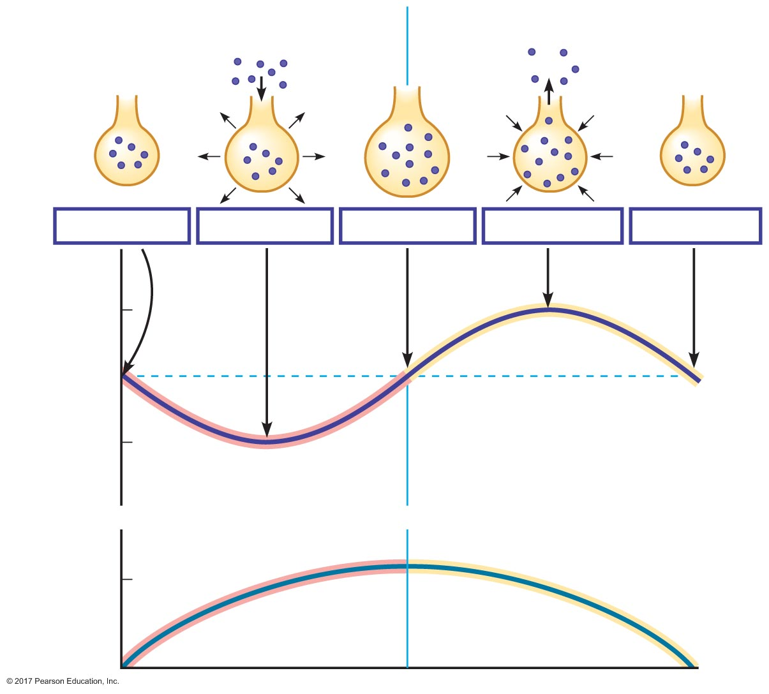
Figure 16.10 Changes in alveolar pressure and breath volume during inspiration and expiration.
Inspiration
Expiration
Air
Air
Airway
Alveoli
Air
molecule
P_{alv} = 0 mm Hg
P_{alv} = –1 mm Hg
P_{alv} = 0 mm Hg
P_{alv} = +1 mm Hg
P_{alv} = 0 mm Hg
1
0
Intra-alveolar pressure (mm Hg)
–1
0.5
Breath volume (L)
0

Slide 39
Mechanics of Breathing
Inspiratory muscles increase volume of thoracic cavity
Diaphragm
External intercostals
Expiratory muscles decrease volume of thoracic cavity
Internal intercostals
Abdominal muscles

Slide 40
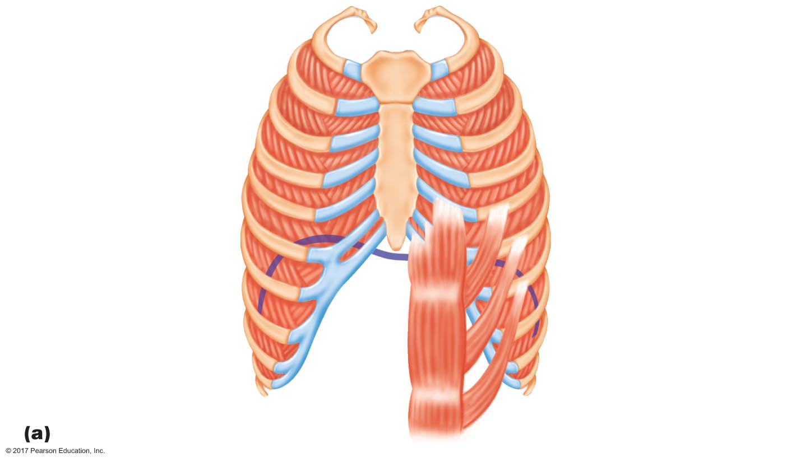
Figure 16.11a Respiratory muscles.
Internal
intercostal
muscles
External
intercostal
muscles
Inspiratory
muscles
Expiratory
muscles
Diaphragm
Abdominal
muscles

Slide 41
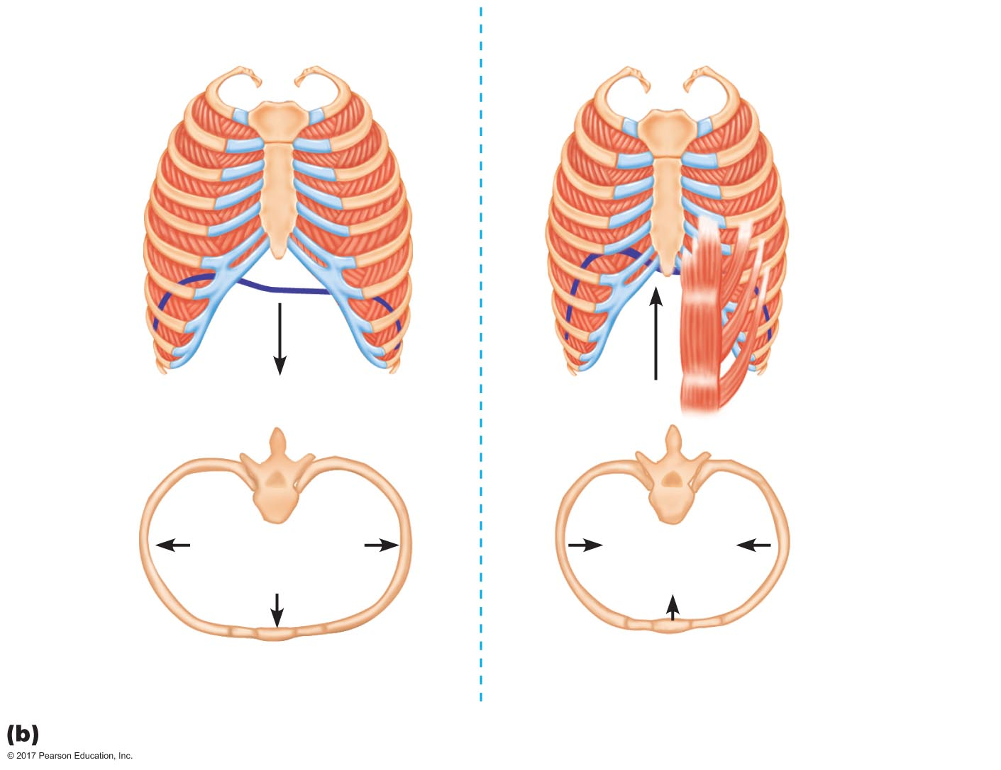
Figure 16.11b Respiratory muscles.
Inspiration
Expiration
External
intercostals
relax
External
intercostals
contract
Internal
intercostals
and abdominals
contract for
active expiration
only
Diaphragm contracts
Diaphragm
relaxes
Chest wall and
lungs expand
Chest cavity
and lungs
contract
Expansion of ribs moves
sternum upward and outward
Ribs and sternum depress

Slide 42
Mechanics of Breathing
Inspiration
Neural stimulation of inspiratory muscles
Diaphragm contraction causes it to flatten and move downward
Contraction of external intercostals makes ribs pivot upward and outward, expanding the chest wall
Collectively, thoracic cavity volume increases
Outward pull on pleura decreases intrapleural pressure, which results in an increase in transpulmonary pressure
Alveoli expand, decreasing alveolar pressure
Air flows into alveoli by bulk flow

Slide 43
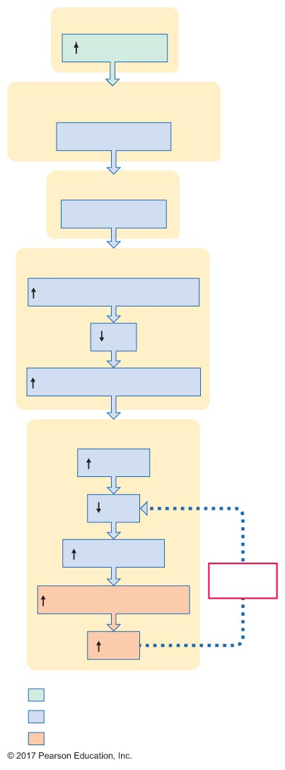
Figure 16.12 Events in the process of inspiration.
Slide 1
Motor neurons
Neural input
Inspiratory muscles
(diaphragm and external intercostals)
Muscles contract
Chest wall
Expansion
Intrapleural space
"Pull" on intrapleural ﬂuid
P_{ip}
Transpulmonary pressure
Alveoli
Volume
P_{alv}
(P_{atm} – P_{alv})
Negative
feedback
Flow of air into alveoli
P_{alv}
Initial stimulus
Physiological response
Result

Slide 44
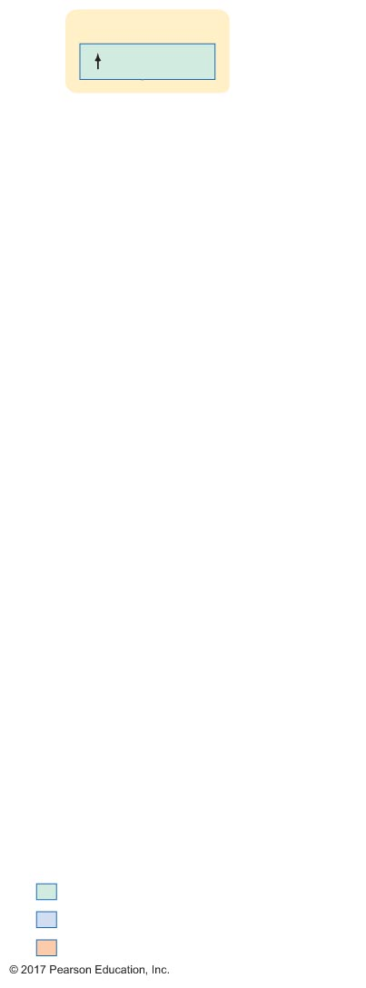
Figure 16.12 Events in the process of inspiration.
Slide 2
Motor neurons
Neural input
Initial stimulus
Physiological response
Result

Slide 45
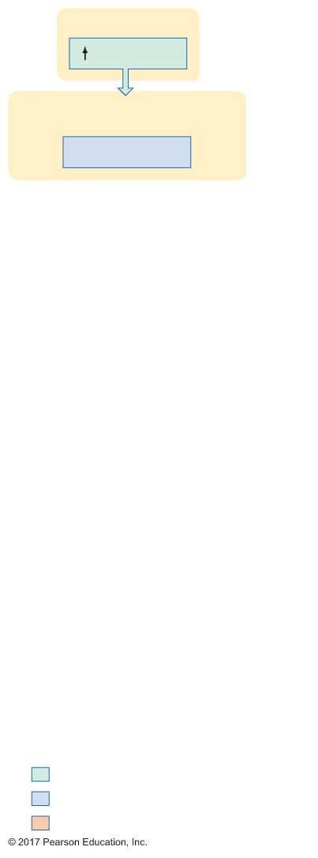
Figure 16.12 Events in the process of inspiration.
Slide 3
Motor neurons
Neural input
Inspiratory muscles
(diaphragm and external intercostals)
Muscles contract
Initial stimulus
Physiological response
Result

Slide 46
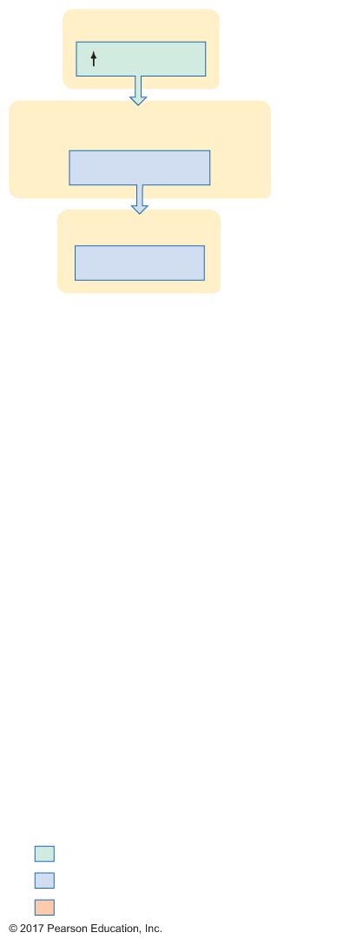
Figure 16.12 Events in the process of inspiration.
Slide 4
Motor neurons
Neural input
Inspiratory muscles
(diaphragm and external intercostals)
Muscles contract
Chest wall
Expansion
Initial stimulus
Physiological response
Result

Slide 47
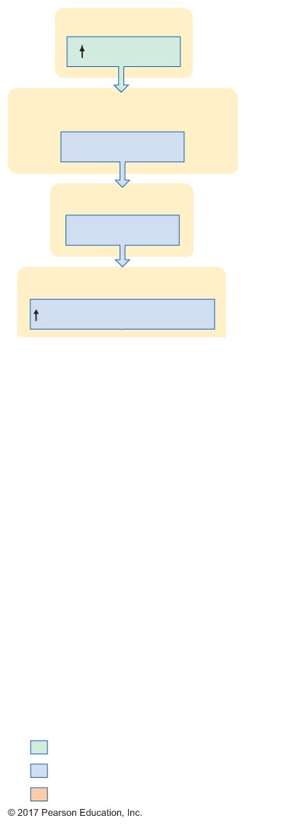
Figure 16.12 Events in the process of inspiration.
Slide 5
Motor neurons
Neural input
Inspiratory muscles
(diaphragm and external intercostals)
Muscles contract
Chest wall
Expansion
Intrapleural space
"Pull" on intrapleural ﬂuid
Initial stimulus
Physiological response
Result

Slide 48
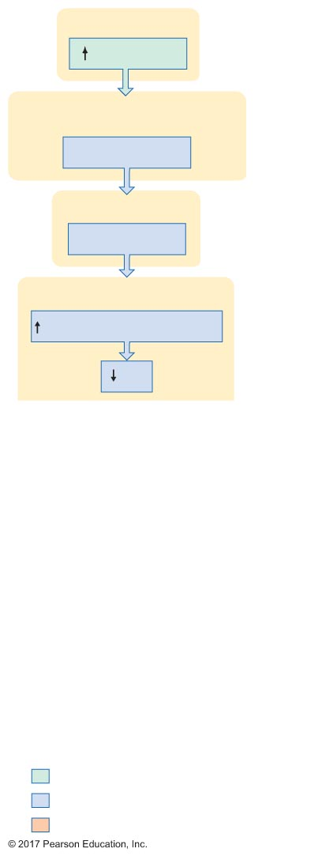
Figure 16.12 Events in the process of inspiration.
Slide 6
Motor neurons
Neural input
Inspiratory muscles
(diaphragm and external intercostals)
Muscles contract
Chest wall
Expansion
Intrapleural space
"Pull" on intrapleural ﬂuid
P_{ip}
Initial stimulus
Physiological response
Result

Slide 49
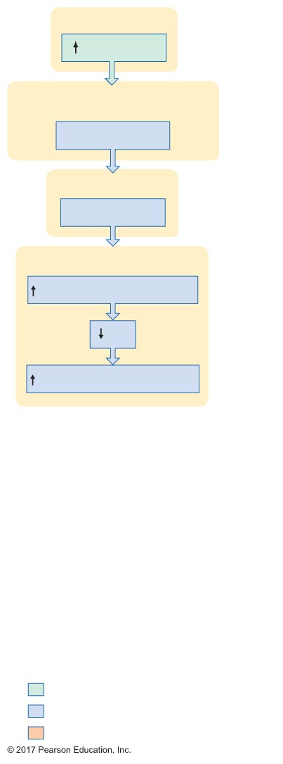
Figure 16.12 Events in the process of inspiration.
Slide 7
Motor neurons
Neural input
Inspiratory muscles
(diaphragm and external intercostals)
Muscles contract
Chest wall
Expansion
Intrapleural space
"Pull" on intrapleural ﬂuid
P_{ip}
Transpulmonary pressure
Initial stimulus
Physiological response
Result

Slide 50
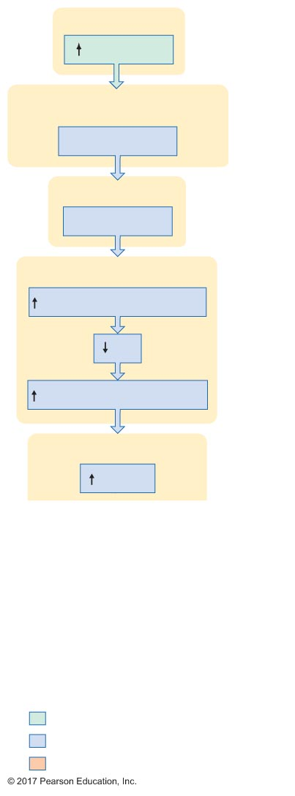
Figure 16.12 Events in the process of inspiration.
Slide 8
Motor neurons
Neural input
Inspiratory muscles
(diaphragm and external intercostals)
Muscles contract
Chest wall
Expansion
Intrapleural space
"Pull" on intrapleural ﬂuid
P_{ip}
Transpulmonary pressure
Alveoli
Volume
Initial stimulus
Physiological response
Result

Slide 51
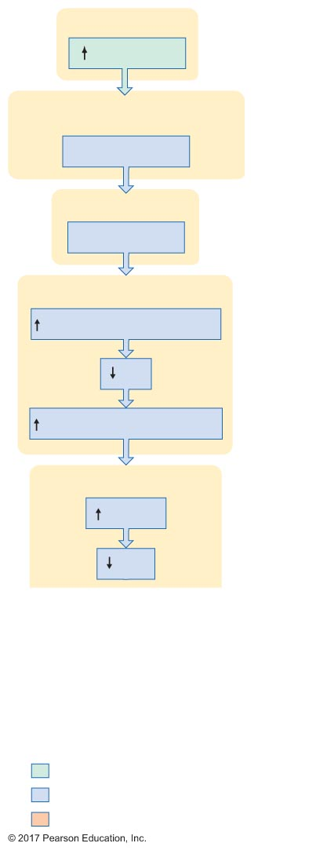
Figure 16.12 Events in the process of inspiration.
Slide 9
Motor neurons
Neural input
Inspiratory muscles
(diaphragm and external intercostals)
Muscles contract
Chest wall
Expansion
Intrapleural space
"Pull" on intrapleural ﬂuid
P_{ip}
Transpulmonary pressure
Alveoli
Volume
P_{alv}
Initial stimulus
Physiological response
Result

Slide 52
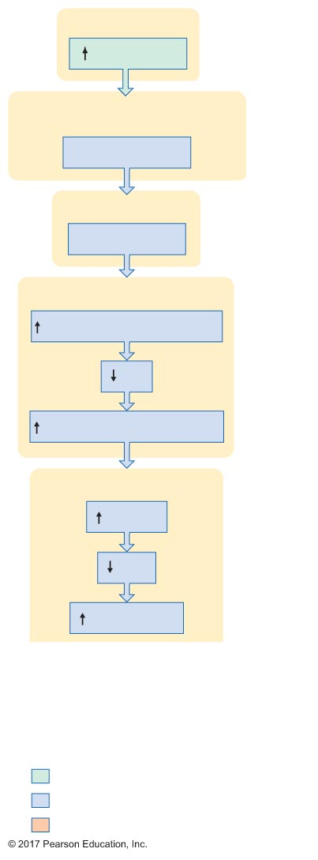
Figure 16.12 Events in the process of inspiration.
Slide 10
Motor neurons
Neural input
Inspiratory muscles
(diaphragm and external intercostals)
Muscles contract
Chest wall
Expansion
Intrapleural space
"Pull" on intrapleural ﬂuid
P_{ip}
Transpulmonary pressure
Alveoli
Volume
P_{alv}
(P_{atm} – P_{alv})
Initial stimulus
Physiological response
Result

Slide 53
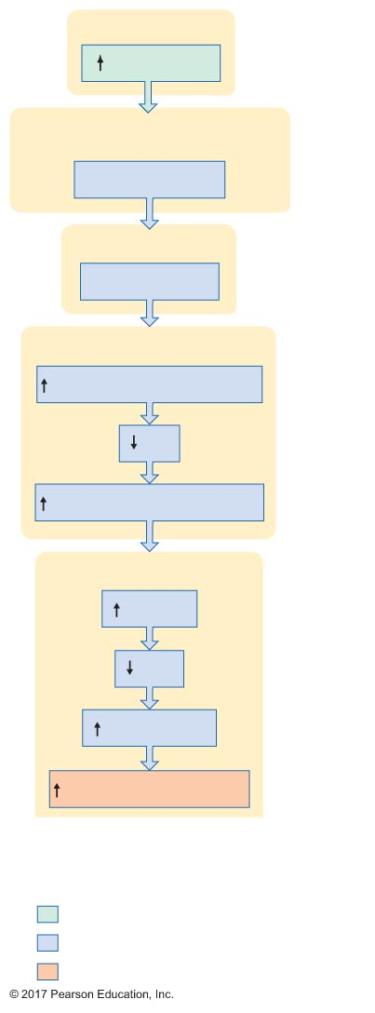
Figure 16.12 Events in the process of inspiration.
Slide 11
Motor neurons
Neural input
Inspiratory muscles
(diaphragm and external intercostals)
Muscles contract
Chest wall
Expansion
Intrapleural space
"Pull" on intrapleural ﬂuid
P_{ip}
Transpulmonary pressure
Alveoli
Volume
P_{alv}
(P_{atm} – P_{alv})
Flow of air into alveoli
Initial stimulus
Physiological response
Result

Slide 54
Figure 16.12 Events in the process of inspiration.
Slide 12
Motor neurons
Neural input
Inspiratory muscles
(diaphragm and external intercostals)
Muscles contract
Chest wall
Expansion
Intrapleural space
"Pull" on intrapleural ﬂuid
P_{ip}
Transpulmonary pressure
Alveoli
Volume
P_{alv}
(P_{atm} – P_{alv})
Negative
feedback
Flow of air into alveoli
P_{alv}
Initial stimulus
Physiological response
Result

Slide 55
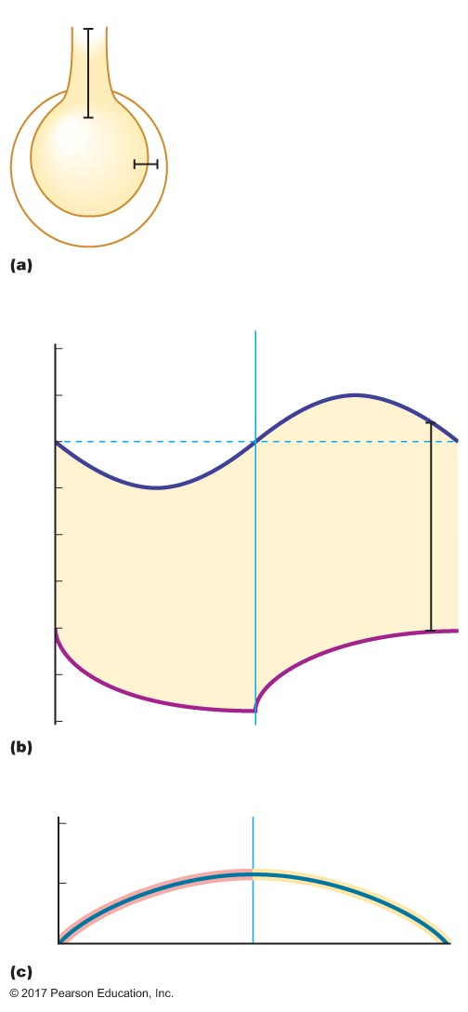
Figure 16.13 Volume and pressure changes during inspiration and expiration.
P_{atm}
Pressure gradient for ventilation
(P_{atm} – P_{alv})
P_{alv}
Chest wall
P_{ip}
Transpulmonary pressure
(P_{alv} – P_{ip})
2
Inspiration
Expiration
P_{alv}
1
0
–1
Transpulmonary
pressure
Pressure relative to atmospheric pressure (mm Hg)
–2
–3
–4
–5
P_{ip}
–6
1
0.5
Breath volume (L)
0

Slide 56
Mechanics of Breathing
Expiration
Normally a passive process
When inspiratory muscles stop contracting, recoil of the lungs and chest wall to their original positions decreases the volume of the thoracic cavity
Active expiration requires expiratory muscles
Contraction of expiratory muscles creates a greater and faster decrease in the volume of the thoracic cavity

Slide 57
16.4 Factors Affecting Pulmonary Ventilation
Lung compliance
Airway resistance

Slide 58
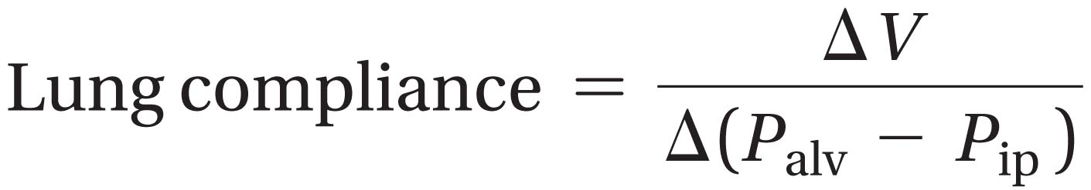
Lung Compliance
Ease with which lungs can be stretched
Larger lung compliance
Easier to inspire
Smaller change in transpulmonary pressure needed to bring in a given volume of air

Slide 59
Lung Compliance
Factors affecting lung compliance
Elasticity
More elastic → less compliant
Surface tension of lungs
Surface tension: force for alveoli to collapse or resist expansion
Thin layer of fluid lines alveoli
Surface tension arises due to attractions between water molecules
Greater tension → less compliant

Slide 60
Lung Compliance
To overcome surface tension
Surfactant secreted from type II cells
Surfactant: detergent that decreases surface tension
Surfactant increases lung compliance
Makes inspiration easier

Slide 61
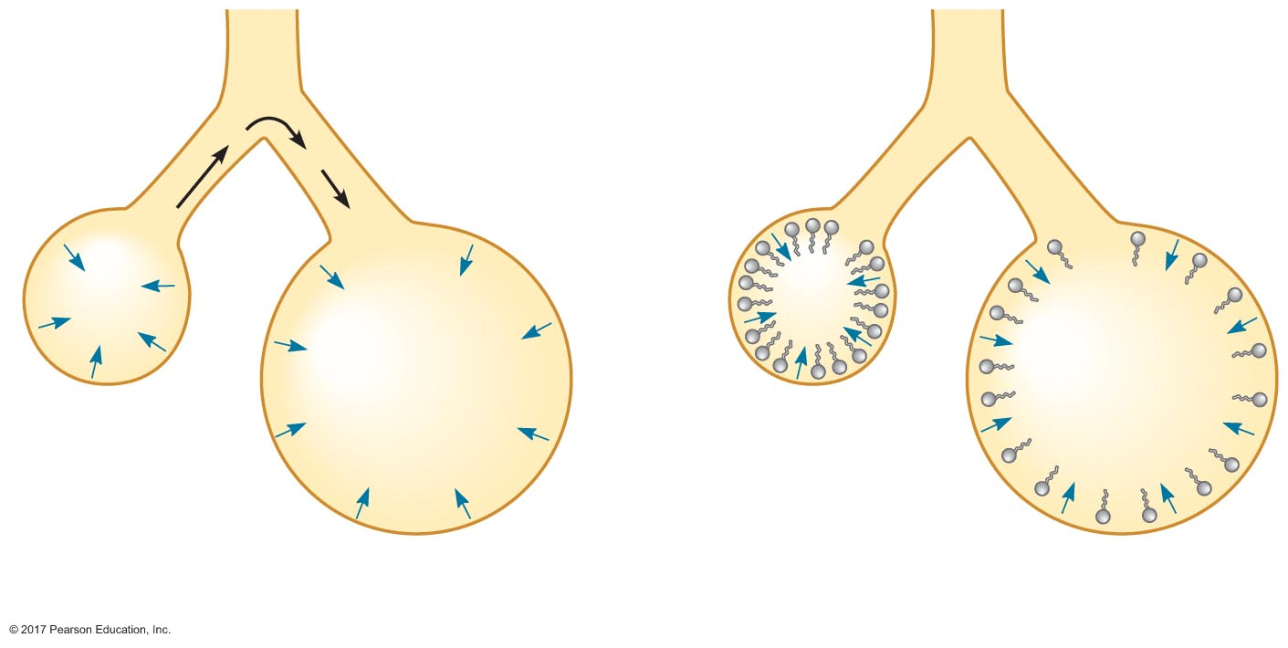
Toolbox 16.5
Airways
No surfactant
in alveoli
Surfactant
in alveoli
Alveolus 1
Air
Alveolus 2
P₁
P₁
P₂
P₂
Surfactant
molecules
r₁ < r₂, P₁ > P₂
Smaller alveolus collapses into larger
r₁ < r₂, P₁ = P₂
Alveoli do not collapse

Slide 62
Airway Resistance
As airways get smaller in diameter, they increase in number, keeping overall resistance low
Pressure gradient is needed for air flow, so resistance is normally low
~1 mm Hg
Increase in resistance makes it harder to breathe
Pressure gradient needed for air flow: > 1 mm Hg

Slide 63
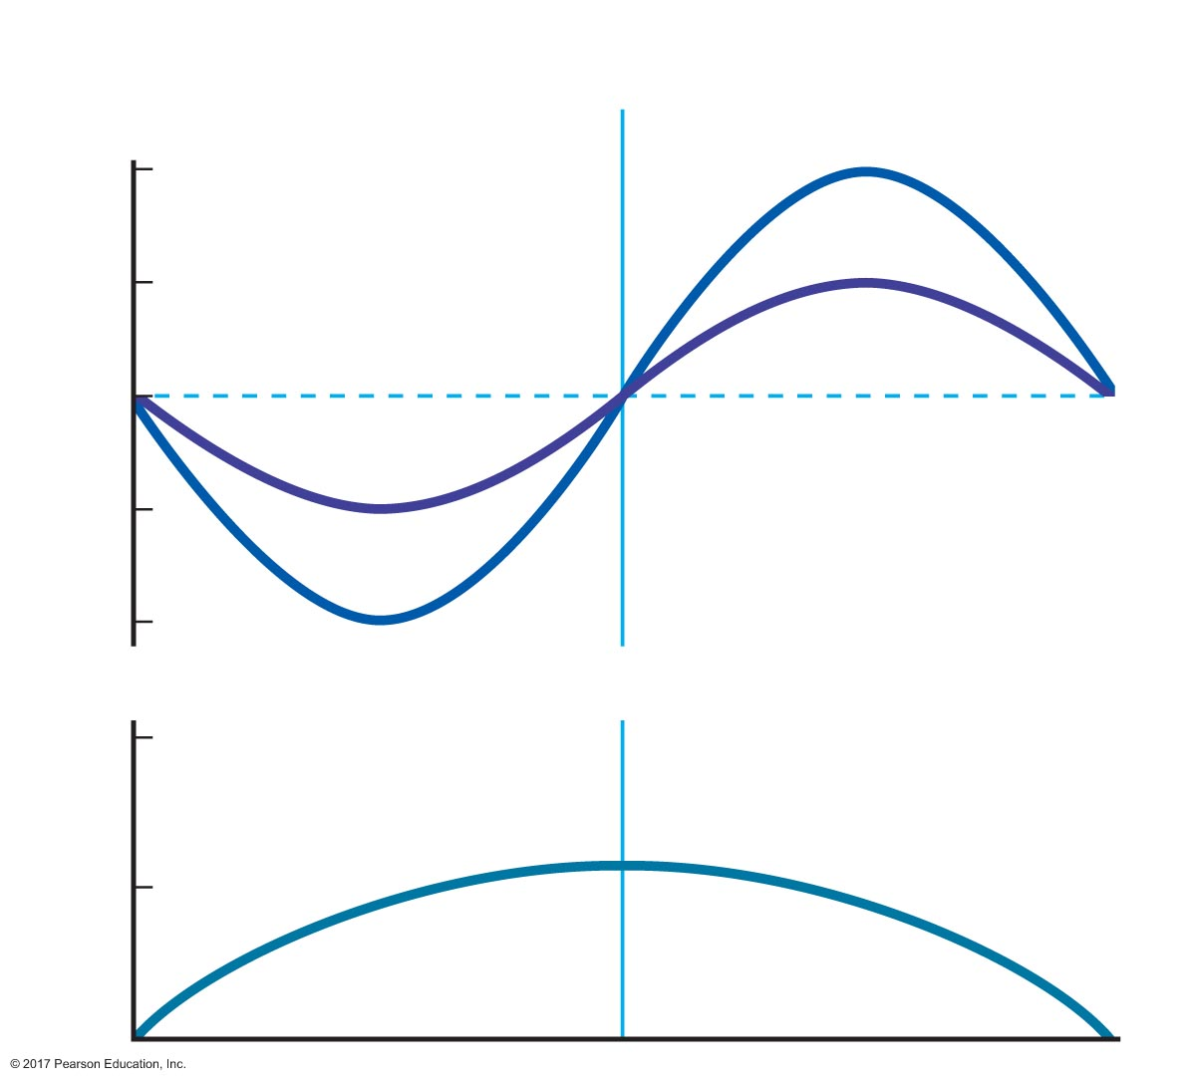
Figure 16.14 Effects of increasing airway resistance on the pressure changes required to move a fixed volume of air.
Inspiration
Expiration
Increased
resistance
2
1
Intra-alveolar pressure (mm Hg)
0
Normal
resistance
–1
–2
1
Volume of air moved
into and out of lungs
0.5
Breath volume (L)
0

Slide 64
Airway Resistance
Factors affecting airway resistance
Passive forces
Changes in transpulmonary pressure during respiratory cycle
Inspiration: transpulmonary pressure increases, causing airways to expand
Tractive forces
Inspiration: as tissues move away from airways, they pull the airways open
Contractile activity of smooth muscle
Mucus secretion

Slide 65
Airway Resistance
Role of bronchiolar smooth muscle in airway resistance
Bronchoconstriction: smooth muscle contracts, causing radius to decrease
Bronchodilation: smooth muscle relaxes, causing radius to increase
Contractile state of bronchiolar smooth muscle under extrinsic and intrinsic controls

Slide 66
Airway Resistance
Extrinsic control of bronchiole radius
Autonomic nervous system
Sympathetic
Relaxation of smooth muscle
Bronchodilation
Parasympathetic
Contraction of smooth muscle
Bronchoconstriction

Slide 67
Airway Resistance
Extrinsic control of bronchiole radius
Hormonal control
Epinephrine
Relaxation of smooth muscle
Bronchodilation
Intrinsic control of bronchiole radius
Histamine: bronchoconstriction
Released during asthma and allergies
Also increases mucus secretion
CO₂: bronchodilation

Slide 68
Airway Resistance
Pathological states that increase airway resistance
Asthma
Caused by spastic contractions of bronchiolar smooth muscle
Chronic obstructive pulmonary diseases
COPD

Slide 69
16.5 Clinical Significance of Respiratory Volumes and Air Flows
Lung volumes and capacities
Pulmonary function tests
Alveolar ventilation

Slide 70
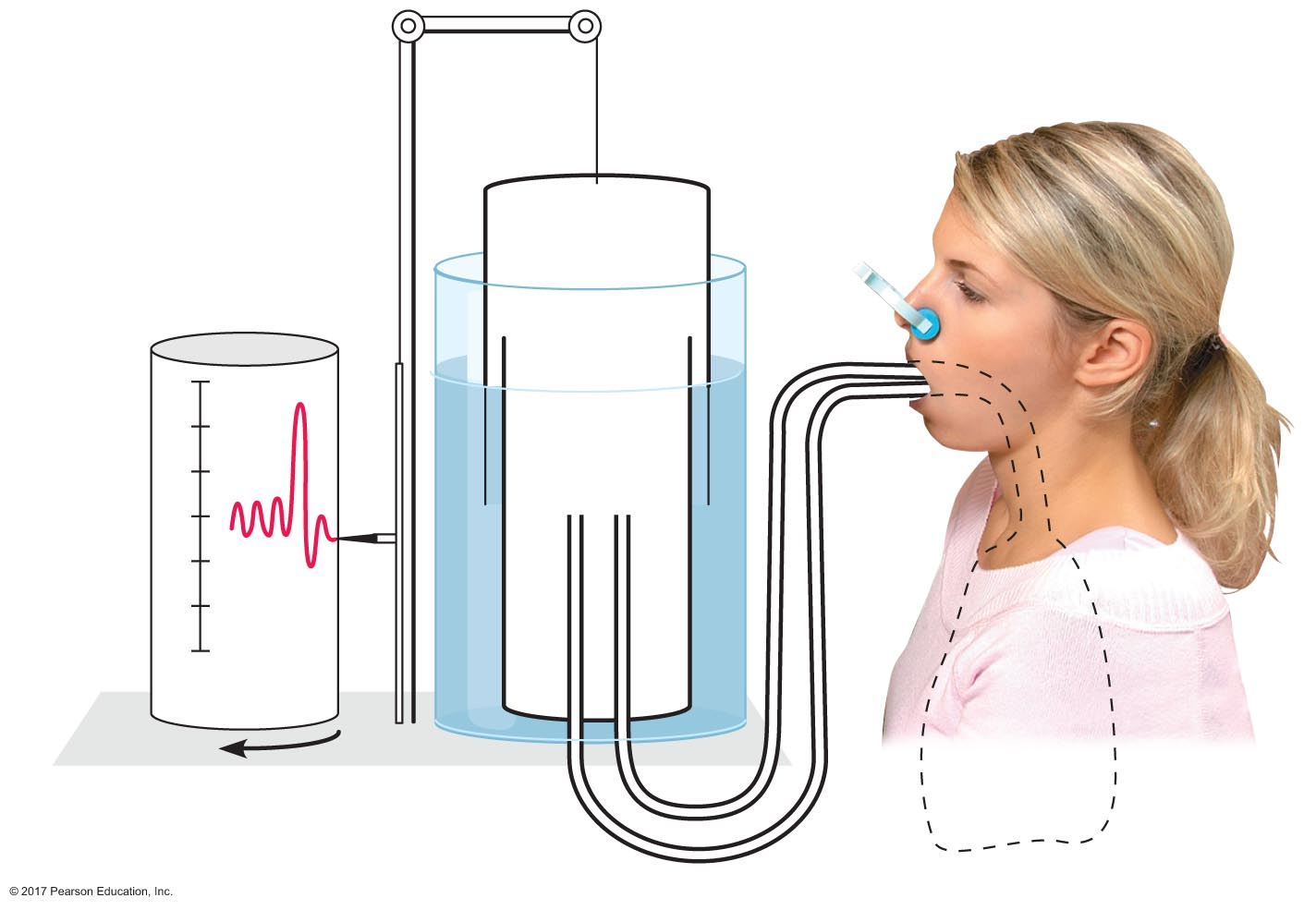
Figure 16.15 Spirometry.
Air
Water
Pen
6
5
Volume
of air (L)
4
3
2
1
0
Rotation
of drum at
ﬁxed rate

Slide 71
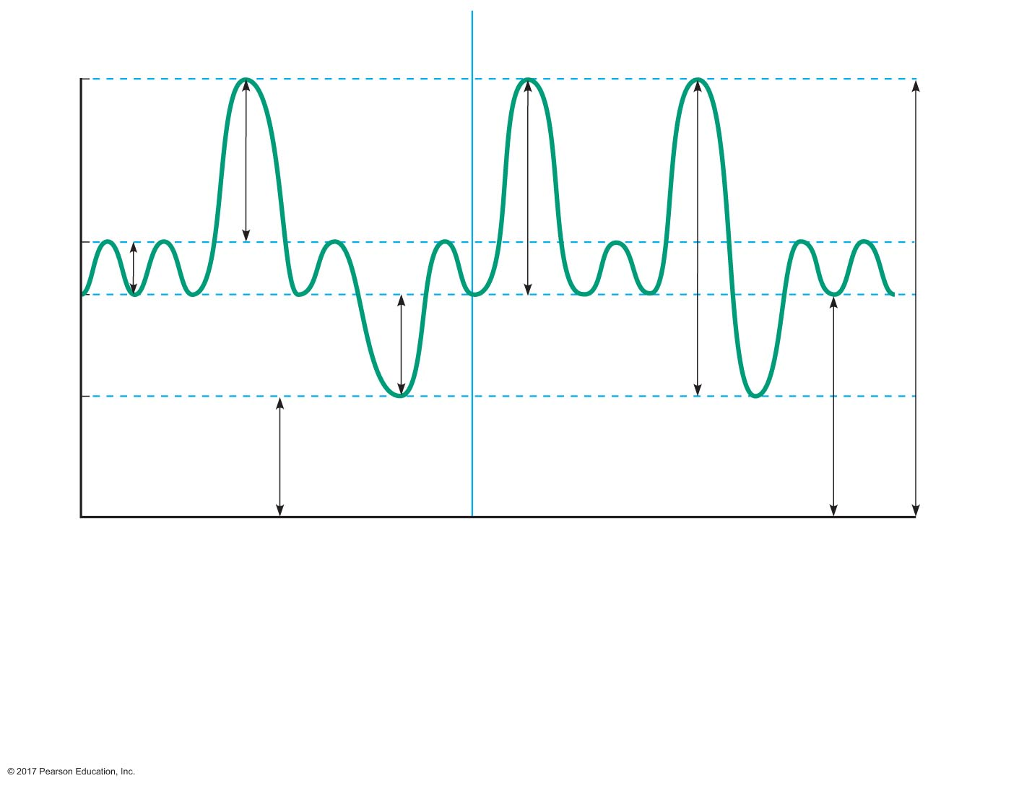
Figure 16.16 Lung volumes and capacities measured using spirometry.
End of
maximum
inspiration
Lung Volumes
Lung Capacities
5700
IC =
V_{T} + IRV
End of
normal
inspiration
TLC =
V_{T} + ERV +
IRV + RV
IRV
V_{T}
2700
2200
Volume (mL)
End of
normal
expiration
ERV
VC =
V_{T} + IRV + ERV
FRC =
ERV + RV
1200
End of
maximum
expiration
RV*
0
Time
Normal lung volumes and capacities for a healthy, approximately 154-lb. male
Lung Volumes
Lung Capacities
V_{T} = Tidal volume = 500 mL
IC = Inspiratory capacity = V_{T} + IRV = 3500 mL
IRV = Inspiratory reserve volume = 3000 mL
VC = Vital capacity = V_{T} + IRV + ERV = 4500 mL
ERV = Expiratory reserve volume = 1000 mL
FRC = Functional residual capacity = ERV + RV = 2200 mL
RV = Residual volume* = 1200 mL
TLC = Total lung capacity = V_{T} + ERV + IRV + RV = 5700 mL
*Cannot be measured by spirometry

Slide 72
Lung Volumes and Capacities
Total lung capacity
Tidal volume (V_{T}): 500 mL
Single, unforced breath
Inspiratory reserve volume (IRV): 3000 mL
After breathing in, volume you can still inspire
Expiratory reserve volume (ERV): 1000 mL
After breathing out, volume you can still expire
Residual volume (RV): 1200 mL
Volume left after ERV
Measurable by helium dilution method

Slide 73
Lung Volumes and Capacities
Inspiratory capacity (IC) = V_{T} + IRV = 3500 mL
Vital capacity (VC) = maximum volume expired after maximum inspiration
VC = V_{T} + IRV + ERV = 4500 mL
Functional residual capacity (FRC) = volume remaining after resting tidal volume
FRC = ERV + RV = 2200 mL
Total lung capacity (TLC) = volume air in lungs after maximum inspiration
TLC = V_{T} + IRV + ERV + RV = 5700 mL

Slide 74
Pulmonary Function Tests
Obstructive pulmonary diseases
Associated with increased airway resistance
Residual volume increases (making it more difficult to expire)
Functional residual capacity increases
Vital capacity decreases
Major obstructive pulmonary diseases
COPD (chronic bronchitis and emphysema)
Asthma

Slide 75
Pulmonary Function Tests
Restrictive pulmonary diseases
More difficult for lungs to expand
Total lung capacity decreases
Vital capacity decreases

Slide 76
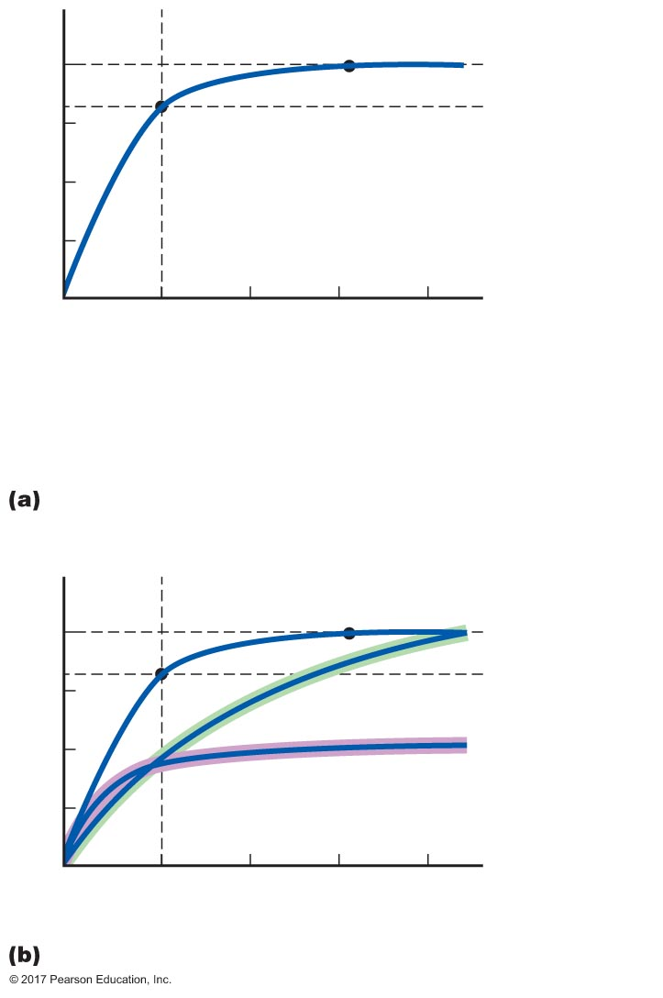
Figure 16.17 Pulmonary function test.
4
FVC
3
Volume exhaled
in 1 second
Volume expired (L)
2
1
1
2
3
4
Time (sec)
FEV₁ =
Volume exhaled in 1 sec
× 100% =
FVC
3200 mL
× 100% = 80%
4000 mL
Normal
4
3
Obstructive
Volume expired (L)
2
1
Restrictive
1
2
3
4
Time (sec)

Slide 77
Pulmonary Function Tests
Forced vital capacity (FVC) = maximum-volume inhalation followed by exhalation as fast as possible
Low FVC indicates restrictive pulmonary disease
Forced expiratory volume (FEV) = percentage of FVC that can be exhaled within certain time frame
FEV₁ = percentage of FVC that can be exhaled within 1 second
Normal FEV₁ = 80%
If FVC = 4000 mL, should expire 3200 mL in 1 sec
FEV₁ < 80% indicates obstructive pulmonary disease

Slide 78
Pulmonary Function Tests
Peak expiratory flow rate (PEFR) = maximum rate at which a person can exhale
Men = 9 L/sec
Women = 7 L/sec

Slide 79
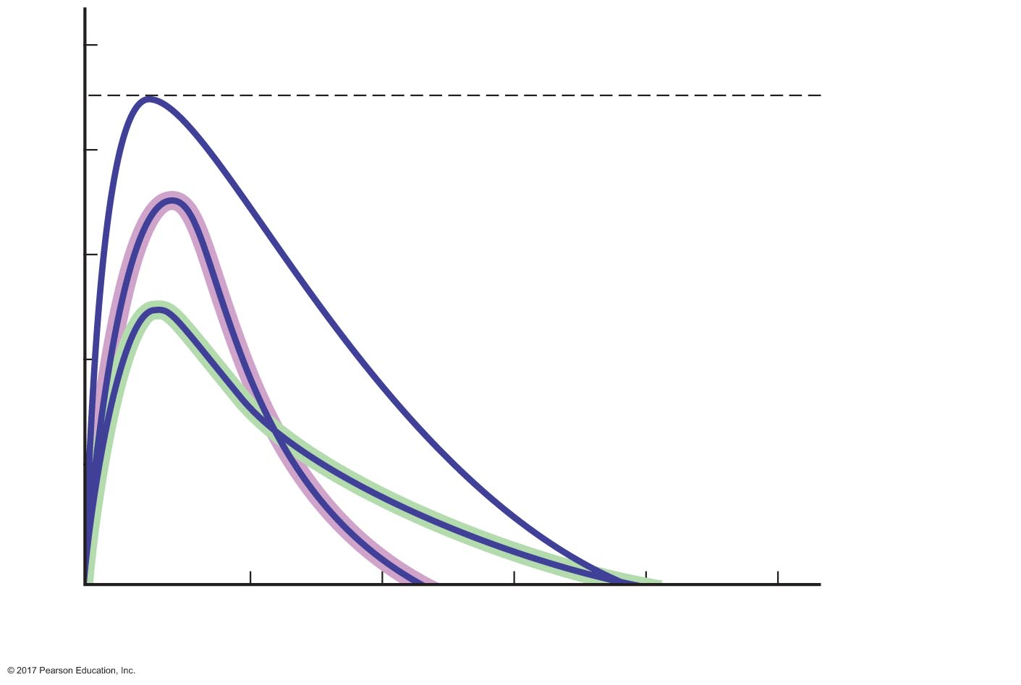
Figure 16.18 Flow-volume curve for expiration.
10
Peak expiratory
flow rate
8
Normal
6
Flow (L/sec)
4
Restrictive
2
Obstructive
1
2
3
4
5
Volume (L)

Slide 80
Alveolar Ventilation
Minute ventilation = total volume of air entering and leaving the respiratory system each minute
Minute ventilation = V_{T} × RR
Normal respiration rate = 12 breaths/min
Normal V_{T} = 500 mL
Normal minute ventilation = 500 mL × 12 breaths/min = 6000 mL/min

Slide 81
Alveolar Ventilation
Anatomical dead space
Air in conducting zone does not participate in gas exchange
Conducting zone = anatomical dead space
Dead space = approximately 150 mL

Slide 82
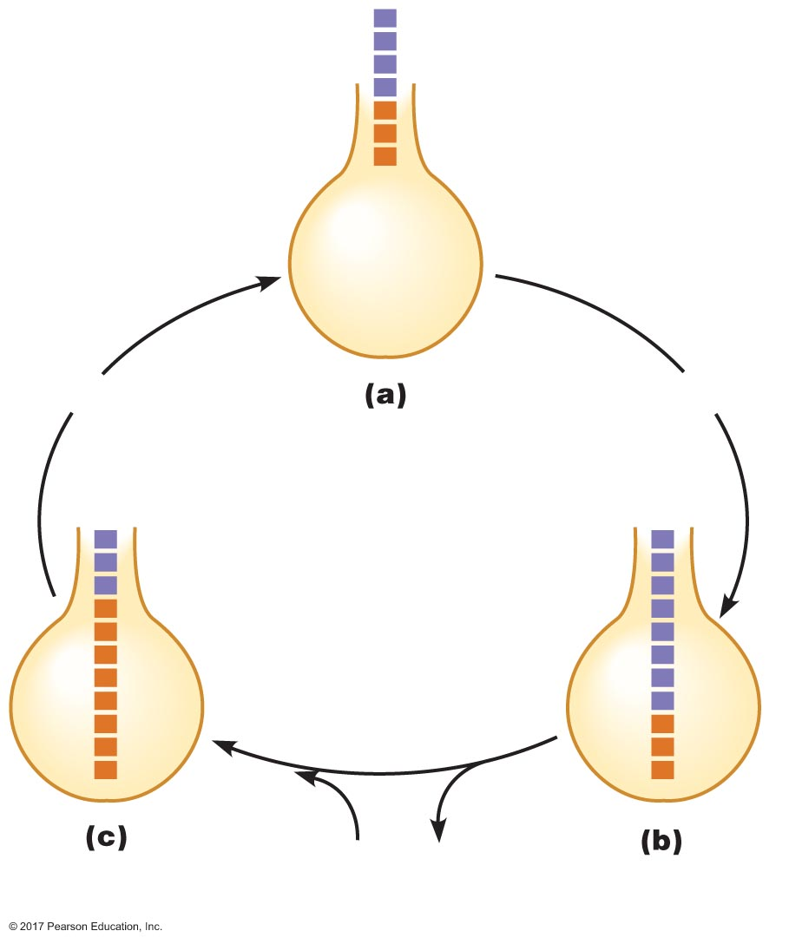
Figure 16.19 The effects of anatomical dead space on alveolar ventilation.
Slide 1
Conducting
zone
(anatomical
dead space)
Fresh air
"Old air"
Alveolus
Expiration
Inspiration
CO₂
O₂
Exchange with blood

Slide 83
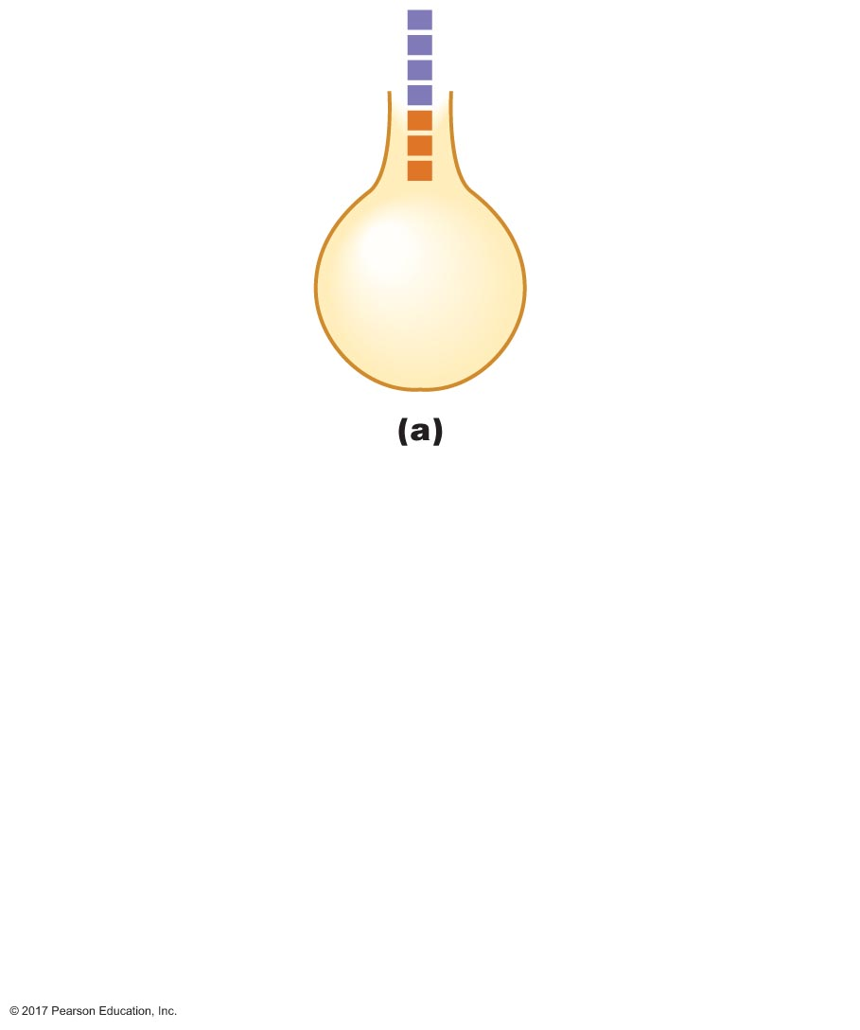
Figure 16.19 The effects of anatomical dead space on alveolar ventilation.
Slide 2
Conducting
zone
(anatomical
dead space)
Fresh air
"Old air"
Alveolus

Slide 84
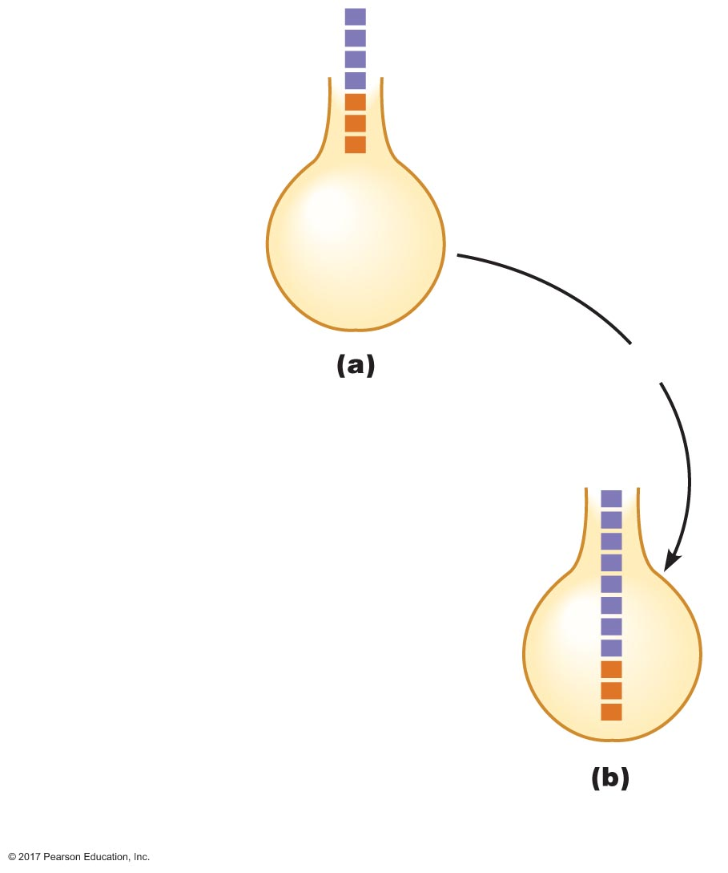
Figure 16.19 The effects of anatomical dead space on alveolar ventilation.
Slide 3
Conducting
zone
(anatomical
dead space)
Fresh air
"Old air"
Alveolus
Inspiration

Slide 85
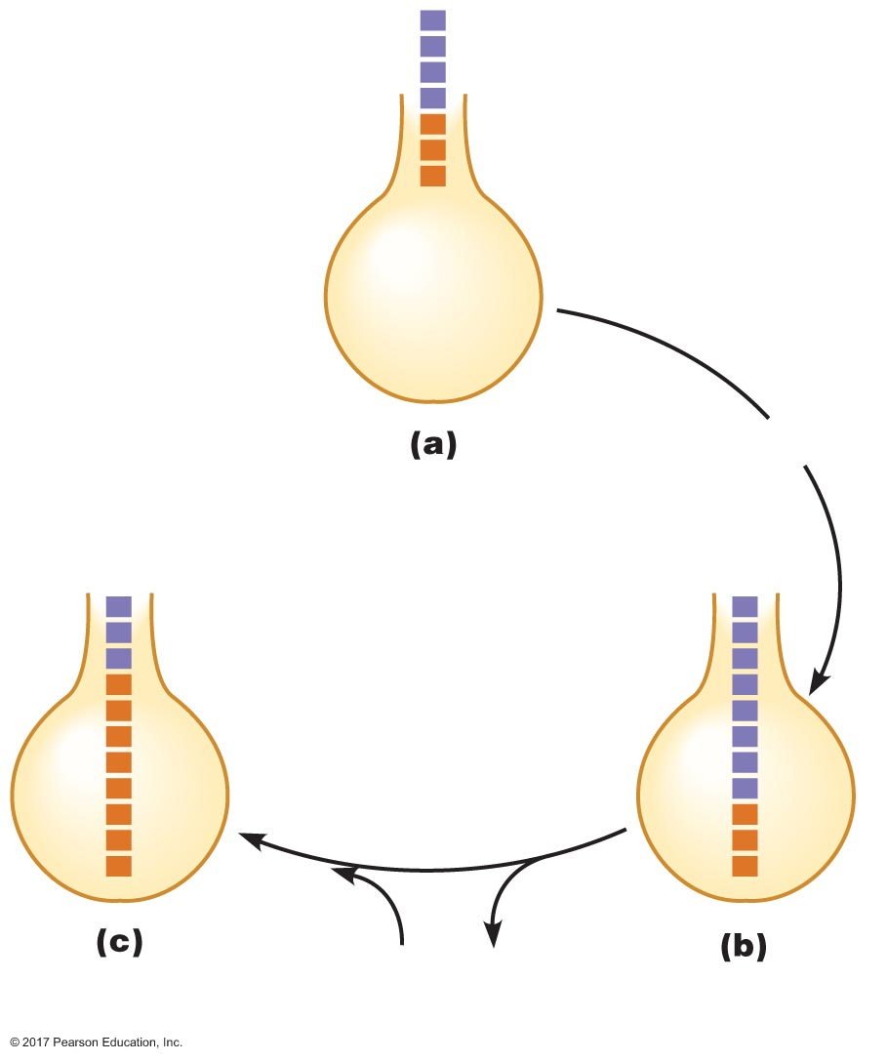
Figure 16.19 The effects of anatomical dead space on alveolar ventilation.
Slide 4
Conducting
zone
(anatomical
dead space)
Fresh air
"Old air"
Alveolus
Inspiration
CO₂
O₂
Exchange with blood

Slide 86
Figure 16.19 The effects of anatomical dead space on alveolar ventilation.
Slide 5
Conducting
zone
(anatomical
dead space)
Fresh air
"Old air"
Alveolus
Expiration
Inspiration
CO₂
O₂
Exchange with blood

Slide 87
Alveolar Ventilation
Volume of air reaching the gas exchange areas per minute
Alveolar ventilation = (V_{T} × RR) – (DSV × RR)
Normal = 4200 mL/min
(500 mL/breath × 12 breaths/min) – (150 mL/breath × 12 breaths/min)

Slide 88
